Slide 1
HSC Library Administration Student Orientation

Slide 2
Contents
• About HSC Library Administration Slide 3
• Library Working Hours Slide 4
• Library Membership Slide 5
• Library Departments & Services
- Circulation Department Slide 7
- Reference & Information Services Department Slide 9
- Training & Information Literacy Department (Literature Search & Electronic Resources) Slide 10
- Interlibrary Loan Department Slide 11
- Marketing & Communications Department Slide 11
- Audiovisual Materials Department Slide 12
- Library System & Technology Slide 13
- Other Library Departments Slide 14
• Library Resources
- Online Catalog Slide 17
- Journals Slide 19
- Databases Slide 20
- Digital Collection Slide 21
• Off-Campus Access Slide 22
• HSC Library Departments Chart Slide 23

Slide 3
About HSC Library Administration
The Health Sciences Center Library Administration (HSCLA) is the main source of health information for the faculties of Medicine, Allied Health, Dentistry, Pharmacy and Public Health.
Each Department in the library is highly dedicated in providing HSC faculties with the up most professional services and with the latest medical information.

Slide 4
HSC Library Working Hours
Academic Semester
Sunday - Thursday | 7:30 a.m. – 10:00 p.m.
Friday & Saturday | 8:00 a.m. – 10:00 p.m. (Third Floor Only)
Semester Break
Sunday to Thursday | 7:30 a.m. – 10:00 p.m.
Friday & Saturday | 8:00 a.m. – 10:00 p.m. (Thirds Floor Only)
Holy Month of Ramadan
Sunday to Thursday | 9:30 a.m. – 5:00 p.m. 8:00 p.m. – 1:00 a.m. | 3rd Floor Only
Friday & Saturday | Closed | 3rd Floor Only

Slide 5
Library Membership
HSC Students need to submit the following documents to obtain library membership:
1. Photocopy of student University ID.
2. Photocopy of Student Civil ID.
3. Two Photographs.
4. A completed membership application form.
Membership applications are processed at the Circulation Section
( HSC New Building – 1st floor ).

Slide 6
HSC Library (HSCLA) Departments and Services

Slide 7
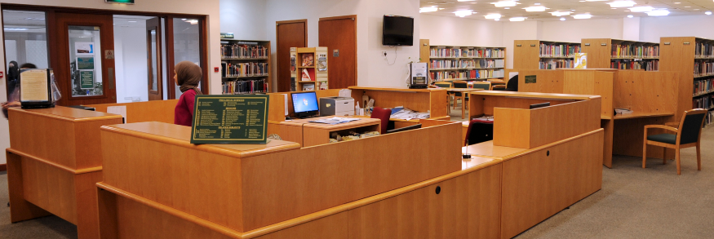
Circulation Department (Books)
قسم الكتب و الإعارة
Circulation Department
The Circulation Desk, Located on the first floor of the library, is the central point for circulating books dating from 1990 onwards. The Circulation Department offers course-related reserve collection recommended by doctors for students and assists patrons in using the library catalog.
The circulation Section bills for late returns and lost items. (Overdue fines are 250 fils per day per item). HSC Students are allowed to borrow 5 books for 2 weeks and 1 reserve book for 2 hours.

Slide 8
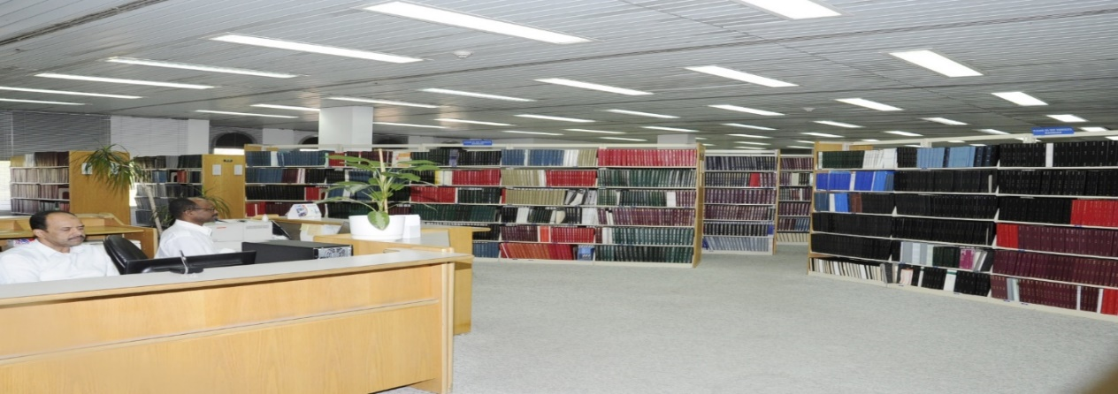
Note:
In the old building, you will find the:
- Reading Room.
- Journal Back Issues dated before 2000.
- Old Books.
- Microfilm Collection dated before 1987.
Back Issues

Slide 9
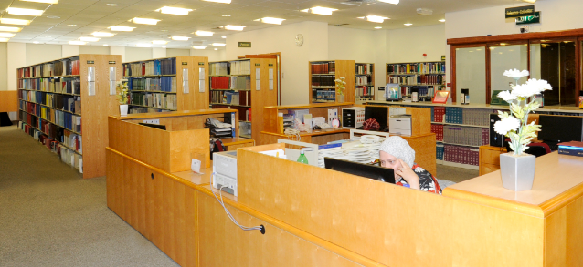
Reference & Information Services Department (Periodicals)
قسم الدوريات
Reference & Information Services Department
The Reference Department, Located on the second floor, is the central point for providing users with general reference services. The collection consists of journals dating from 2000 onwards and standard reference material, such as dictionaries, encyclopedias, manuals and guides.
Reference librarians provide assistance to patrons in the use of library resources (print & electronic) and also perform verification of bibliographic citations.

Slide 10
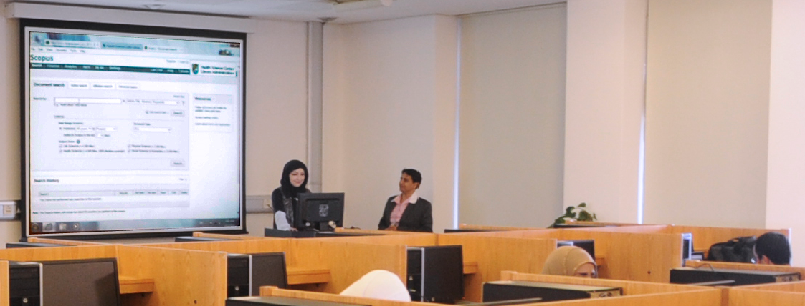
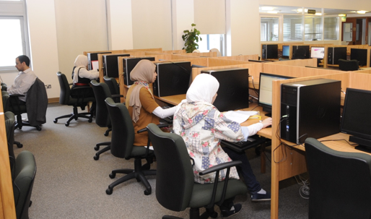
Training & Information Literacy Department
(Literature Search & Electronic Resources)
قسم التدريب والوعي المعلوماتي
Information Literacy & Training Department
The Training & Information Literacy Department, located on the third floor, offers group and individual training sessions to HSC Staff, Students and other Healthcare Professionals. Services include course-related bibliographic and full-text group instruction as well as one-to-one guidance and instruction on accessing online information, the online catalog, eBooks, Databases, Online Journals, locating research articles and access to the world wide web in addition to other electronic resources and digital collections.
Find Guides and Tutorials on how to navigate the library homepage and use the library resources from Lib TUTOR

Slide 11
Interlibrary Loan Department
قسم الإعارة التعاونية
The Interlibrary Loan Department, located on the third floor, assists users in obtaining material that is not part of the library’s collection from regional libraries in the Gulf, the British Library and the Canadian Library.
Marketing & Communications Department
قسم تسويق مقتنيات المكتبة والعلاقات العامة
The Marketing Department, located on the third floor, familiarizes users with the electronic resources available at the HSC Library such as the Online Catalog, eBooks, databases, eJournals and other resources that are newly added to the library collection.
Keep up with the latest news, events and updates from the library by following us on Facebook , Twitter and Instagram.

Slide 12
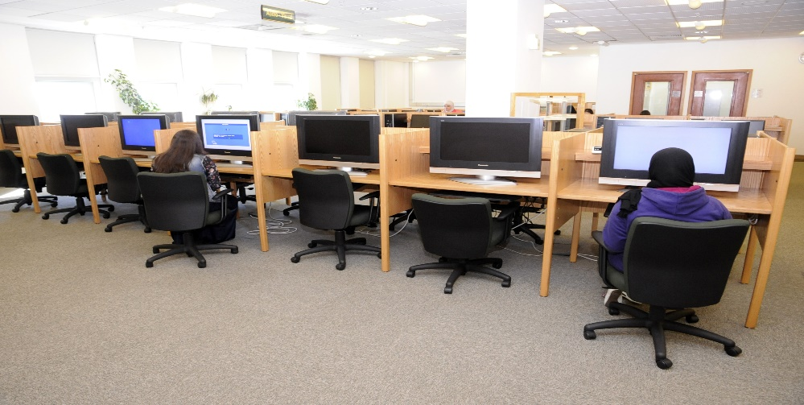
Audiovisual Materials Department
قسم الوسائل السمعية والبصرية
Audiovisual Materials Department
The A/V Department, located on the third floor, provides material such as Compact Disks (CDs), DVDs, Software, Video Cassettes, Audio Cassettes that support teaching and learning at the HSC.
The A/V Department bills for late returns and lost items. (Overdue fines are 250 fils per day per item). HSC Students are allowed to borrow 3 items for three days. HSC Students are only allowed to borrow VCs and ACs off campus. Material such as CDs, DVDs, Software etc. are restricted to in-house viewing.

Slide 13
Library System and Technology Department
قسم النظم الآلية وتقنية المكتبة
The Library System and Technology Department, located on the third floor, is responsible mainly for managing the information technology infrastructure to provide IT services within the HSCLA in alignment with Kuwait University strategic objectives. The department is involved in the study, planning, designing, implementing, and monitoring of any software systems being developed in-house or by a third party.
In addition to managing systems such as the library management system, the department is also handling the library website that has useful information including a list of various database subscriptions that helps the academic staff, students and researchers excel in their medical study and research.
The IT department sets the rules and policies to govern the use of servers, network and hardware components. This involves assessing the risks and vulnerability of the hardware architecture required for the systems, to ensure maximum protection for users. The department also communicates with various departments such as technical support to ensure smooth daily operations.
Access the library homepage at: http://hsclibrary.ku.edu.kw

Slide 14
Other Library Departments
أقسام المكتبة الأخرى
Collection Development Department قسم تطوير المجموعات
Acquisitions Department قسم التزويد
Cataloguing Department قسم الفهرسة

Slide 15
HSC Library (HSCLA) Resources

Slide 16
HSC Library (HSCLA) Resources
HSCLA has a significant amount of resources that include the Library Catalog, eBooks, Databases, Journals and Digital Collection.
Question: How do you find resources such as books and journals at the library?
Answer: You find books and journals by using the Library Catalog.

Slide 17
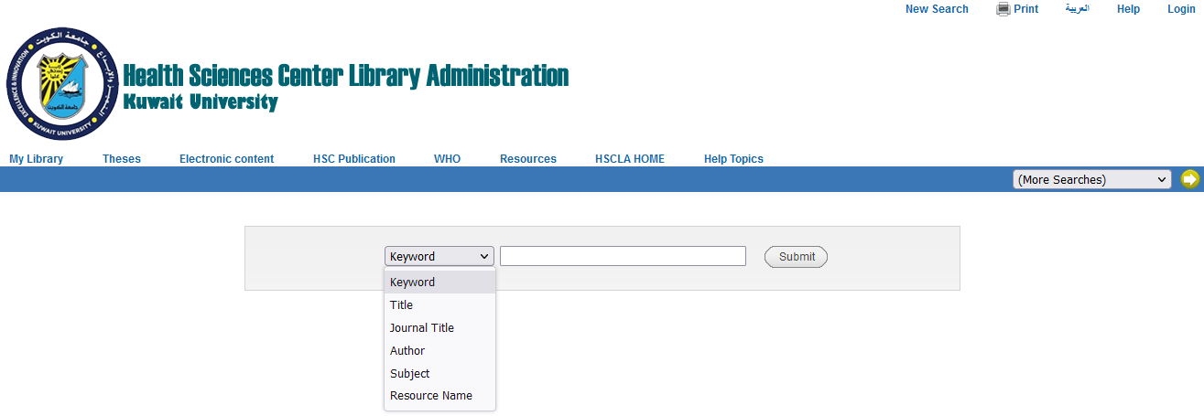
e-Library Catalog (Online Catalog)
فهرس المكتبة))
The Library Catalog provides information about books, journals, audiovisual material and eBooks of HSCLA collection. The online library catalog can be used to search for the availability and location of items in the library. It also allows you to view your account in the library and place hold requests for items.
Search the Catalog by:
-Keyword
-Title
-Journal Title
-Author
-Subject
-Resource Name

Slide 18
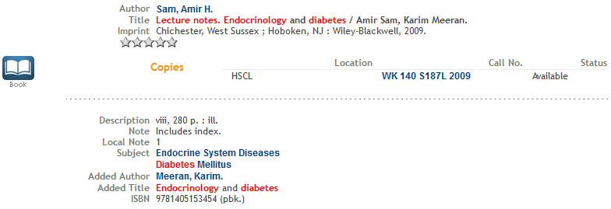
After performing a search using the catalog, you will be provided with full information about the item as well as the Holdings Information of the book or journal.
You will need the Call Number to locate the book on the shelf

Slide 19
Journals
(الدوريات)
Print Journals are located in the reference room while Online journals can be accessed online from the library’s homepage.
To access full text journals online:
-Access the library homepage at: http://hsclibrary.ku.edu.kw
-Click on Periodicals
-Select VDiscovery
Or
- Access the library homepage at: http://hsclibrary.ku.edu.kw
- From Quick Links, Click on VDiscovery
✶ Resources that are not available at the library may be requested from the Interlibrary Loan Section.

Slide 20
Databases
(قواعد المعلومات)
The library is subscribed to numerous databases available for teaching, research and clinical purposes such as:
For the full list of HSCLA databases Click Here
ClinicalKey Student | Science Direct
Cochrane | Scopus
Complete Anatomy | Up-To-Date
Lexicomp | Web of Science
Mc Graw Hill Medical | Wiley Online Library

Slide 21
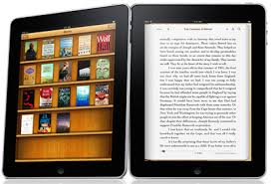
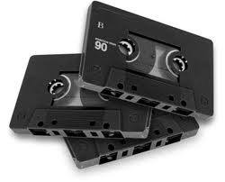
Digital Collection
(المجموعات الرقمية)
The library’s homepage is rich with digital collection which is comprised of eBooks, Audios, CDs, Videos, Arabic Collection, Medical Images & Illustrations, Biomedical Seminar Series, Psychiatric Curriculum and Free medical imaging search engines.

Slide 22
Off-Campus Access to HSC Library (HSCLA) Resources
الدخول لمصادر المكتبة من خارج مركز العلوم الطبية) )
•To obtain VPN off-campus access to the library’s electronic resources, staff and students must open an email account with HSC Technical Support Administration.
- Apply for an email account:
Student Account
•To access VDiscovery off-campus, staff and students must login with KU portal username and password.
•Off Campus Access to Library Resources (VPN Setup):
Tutorial
•For more information about which method to choose for accessing off-campus resources Click Here

Slide 23
HSC Library Administration Departments
Circulation
Acquisitions
Cataloguing
Training & Information Literacy
(Literature Search & Electronic
Resources)
Interlibrary Loan
Audiovisual Materials
Marketing & Communications
Library System & Technology
Collection Development
HSCLA
Back Issues
Reference & Information Services

Slide 24
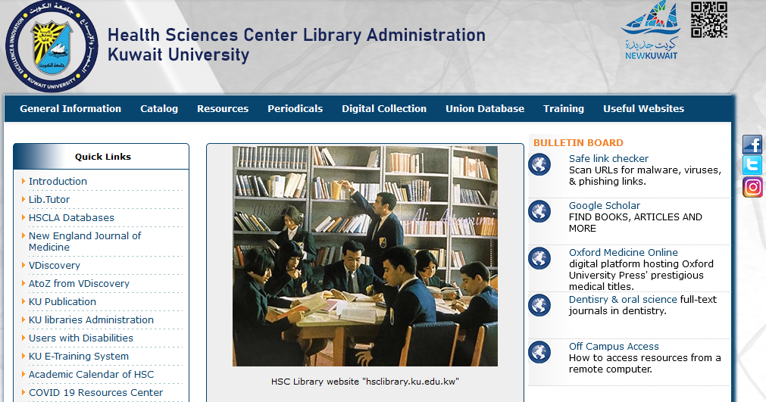
For more information
Visit the HSC Library (HSCLA) Homepage at
http://hsclibrary.ku.edu.kw
Project by: Manal Hasan
Training & Information Literacy Department
(Literature search & Electronic Resources)
HSC Library Administration
Manal.hasan@ku.edu.kw

